Slide 1



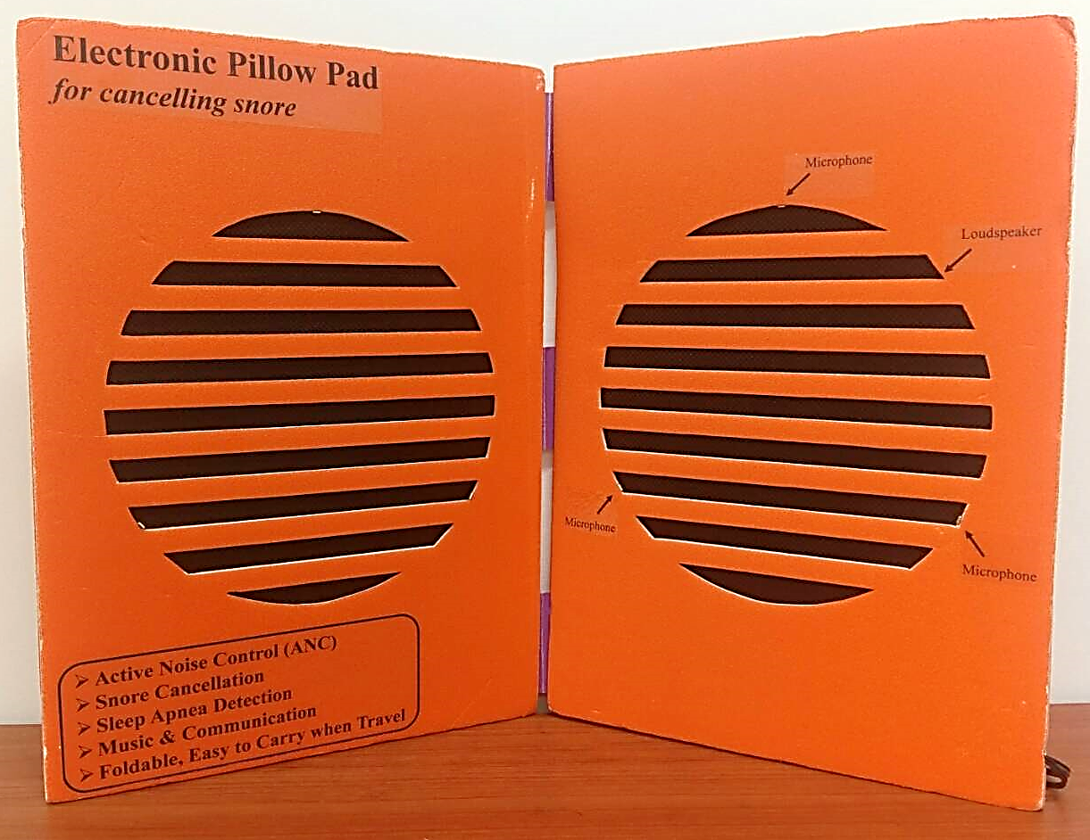
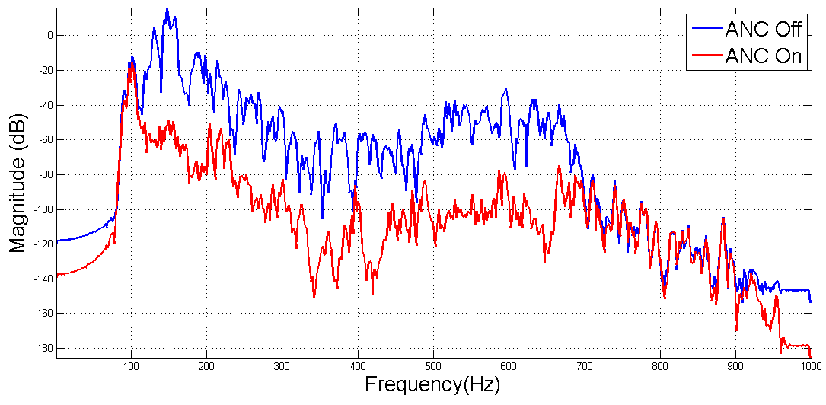
消除鼾聲與噪音之電子枕頭墊及其方法
Electrical Pillow Pad for Snore and Noise Cancellation
Problem Statement
Multiple Functions
Active Noise Control (ANC)
Snore Cancellation
Sleep Apnea Detection
Music & Communication
Foldable, Easy to Carry when Travel
Fast changing snore noise
Head movement
Limitation in size
Basic Idea
Proposed System
Active Noise Control (ANC)
Anti-waveform
Residual
waveform
Waveform
Snore cancellation result
Proposed system
中原大學產學經營暨專利技轉中心 TEL：03-2651831~4 FAX：03-2651809

