Slide 1
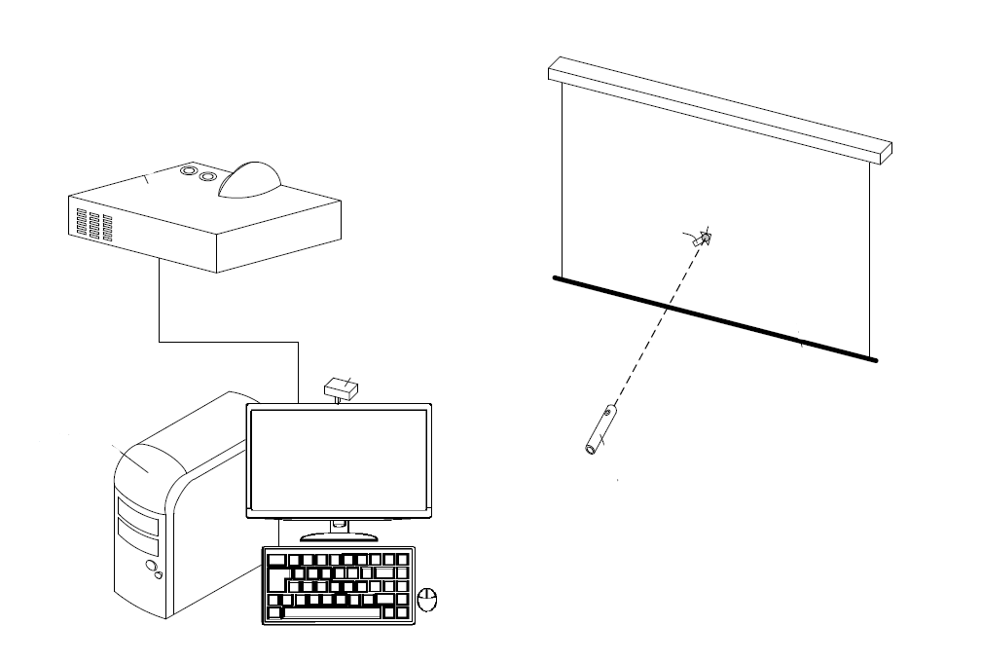
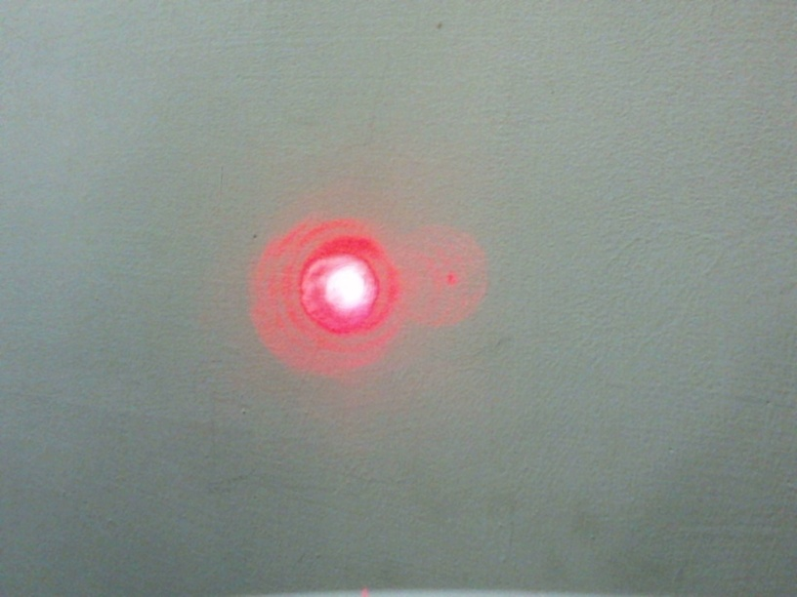
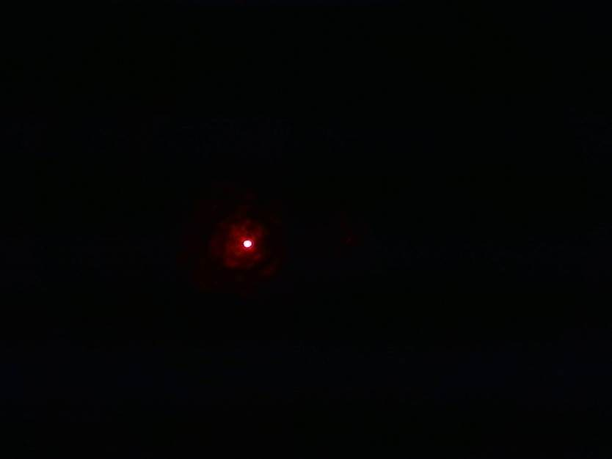
Projection screen laser pointer detecting and locating system
and the method for detecting and locating the same
投影幕雷射筆偵測定位方法
申請案號:106113048
專利國別:中華民國
發明人：林鼎然、陳世綸、潘思清
參展品簡介：
本發明提供一種投影幕雷射筆偵測定位系統與方法，其主要係應用於具有主電腦、投影布幕與投影裝置的電腦投影系統當中，其中，本發明係透過連接於該主電腦之攝像裝置而將主電腦投影於投影布幕上之螢幕進行影像擷取，而當講者透過雷射筆進行簡報時，其電腦鼠標將隨著講者雷射筆所投射之光點位置而進行移動，如此，當進行電腦錄影時，講者使用雷射筆於簡報上的軌跡將同步地於電腦內部以鼠標移動之方式而被記錄下來，進而提升簡報錄影之臨場效果；除此之外，本發明並再透過安裝於主電腦之曝光度調整單元而根據投影布幕上之雷射光點亮度而調整所述攝像裝置之曝光度，進而使得所述攝像裝置之擷取影像中只出現雷射筆之強光光點，進而有效地避免本系統因投影內容所產生之光點位置誤判等狀況。
Introduce:
The present invention provides a projection screen laser pointer detecting and locating system and the method for detecting and locating the same, and the present mainly used in a computer projection system having a main computer, a projection screen and a projection device, wherein, the invention is connected with the main computer through the camera Device and the main computer projection screen projection screen for image capture, and when the speaker through the laser pointer when the briefing, the computer mouse will be the speaker with the laser pointer to move the location of the light point , So when the computer video, the speaker using the laser pointer on the briefing track will be synchronized to the computer within the mouse to move the way to be recorded, thereby enhancing the presentation video of the spot effect; In addition, the And adjusting the exposure degree of the image pickup apparatus according to the brightness of the laser spot on the projection screen by the exposure degree adjustment unit installed in the host computer so as to cause only the laser pointer in the image captured by the image pickup apparatus of the light point,and thus effectively avoid the system due to projection content generated by the light point of misjudgment and other conditions.
簡述專利特色及重要性:
本發明以雷射筆控制相較於現有方案以陀螺儀控制，本發明對於雷射筆在投影幕上的位置，與所估測之電腦內部投影資料上的位置(為受控之滑鼠位置)，之間的誤差可大幅降低。實驗如下。雷射光點與鼠標起始位置設置相同，以雷射光為依據，從螢幕左側移動到螢幕中央，共683個像素點。我們測量50次用兩種方式移動上述距離後的誤差。相較於現有解決方案，本發明可將誤差率降低30.25%。
本發明使用以調整控制曝光度來增加雷射筆之偵測精準度，在偵測投影幕上偵測雷射筆光方法，我們測試系統在不同鏡頭曝光度下的成功率。實驗時以白色背景做測試，雷射光從左側移動到右側，途中若有偵測失效則為失敗，每一情況測100次。數據表示為使用曝光控制時，在白色背景都能準確的偵測，而在自動曝光情況下時容易在白色背景時偵測失敗，導致成功率低。此新穎性可將成功率增加80%。
Characteristics and importance:
This invention designs a method controlling by a laser pen, the invention compared with existing method controlling by gyroscope. The error between the position of the laser pen on the projection screen and the position of the estimated internal projection data of the computer (for the controlled mouse position) can be greatly reduced. The experiment is as follows. The laser spot is set to the same position as the mouse's starting position. Based on the laser light, it moves from the left side of the screen to the center of the screen for a total of 683 pixels. We measured the error after moving the above distance in 50 ways in two ways. Compared to the prior method, the invention can reduce the error rate by 30.25%.
The invention uses the adjustment control exposure to increase the detection accuracy of the laser pointer. In the method of detecting the laser light on the detection projection screen, we test the success rate of the system under different lens exposures. The test was carried out with a white background. The laser light was moved from the left side to the right side. If there was a detection failure on the way, it was a failure, and each condition was measured 100 times. The data indicates that when the exposure control is used, it can be accurately detected on a white background, and in the case of automatic exposure, it is easy to detect failure on a white background. This novelty can increase the success rate by 80%.
圖、鏡頭一般測光的自動曝光 圖、降低鏡頭的曝光度下
中原大學產學經營暨專利技轉中心 TEL：03-2651831~4 FAX：03-2651809

