Slide 1
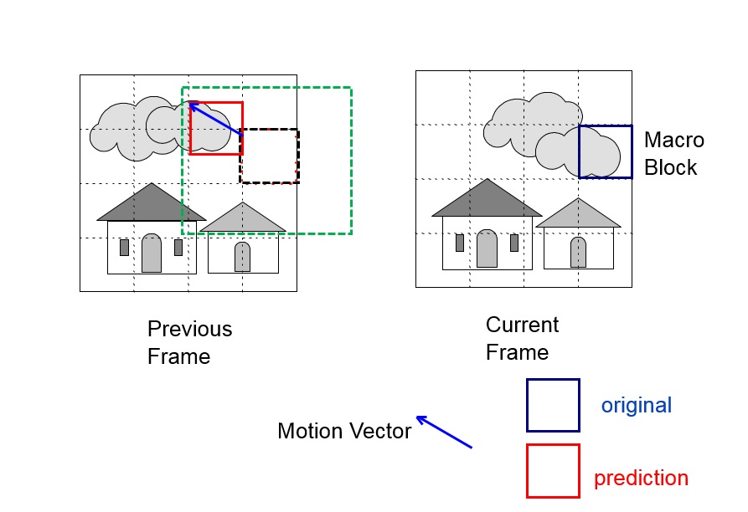
AUTO-SELECTION TYPE SYSTEM FOR CONTROLLING BACKLIGHT MODULE AND METHOD FOR THE SAME
自動選擇式背光控制系統及其方法
專利作者:陳世綸 林鼎然 董昆憲 陳瀅
專利證書號(申請案號):I608463
專利國別:中華民國
參展品簡介：
本發明提出了一種創新的顯示背光控制節能技術。對視訊解碼器MV（運動向量）的分析來進行背光控制，背光控制包括兩種不同的方法；第一種方法是當運動向量的分析值大於某個臨界值時，將對此張畫面進行計算背光功耗和像素補償比率；第二種方法是當運動向量的分析值小於某個臨界值時，使用前一張畫面的背光功耗和像素補償比率，進而不再計算背光功耗和像素補償比率；該方法有效地降低了計算複雜度以增加背光控制性能。本發明的新穎之處在於，它是將運動向量分析用於顯示器背光節能控制的首例。使用目前的技術正規視訊計算的複雜度和時間的花費都有效地降低高達60-90％。
Introduction：
This invention presents an innovative display backlight control energy-saving technology. The backlight control was based on the analysis of video decoder MV (Motion Vector). Backlight control includes two different ways. The first method is when the analysis value of the motion vector is greater than a certain critical value, the frame calculates the backlight energy consumption and the pixel compensation ratio. The second method is when the analysis value of the motion vector is less than a certain critical value, the backlight power consumption and the pixel compensation ratio of the previous frame are used; the backlight energy consumption and pixel compensation ratio is not calculated again. This method effectively reduces the computational complexity to increase the backlight control performance. The novelty of this invention is that it is the first work to use motion vector analysis for display backlight energy saving control.The use of the technology of the present work effectively reduces the computational complexity and time up to 60-90% in a standard video dataset.
Table I. Contribution of this invention
Figure 2. Frame comparison
Figure 1. Motion estimation
Characteristics and importance:
This invention designs a monitor backlight control energy-saving technology. The existing backlight control energy-saving technologies recalculate the backlight energy and the pixel compensation ratio of each display or block for each frame. For 30- to 60- frames-per-second continuous motion video images, it will result in high computational complexity. In addition, delay may also occur and high-speed computing costs is too expensive. This invention presents an innovative display backlight control energy-saving technology. The backlight control is based on the analysis of the video decoder motion vector which is classified into two different methods. The first method is when the analyzed value of the motion vector is greater than a certain critical value, the image calculates the backlight energy consumption and the pixel compensation ratio, as in existing methods. The second method is when the analyzed value of the motion vector is less than a certain critical value, the backlight power consumption and the pixel compensation ratio of the previous frame is used; the backlight energy consumption and pixel compensation ratio is not calculated on the screen again to save computational complexity. This method effectively reduced the computational complexity to increase the backlight control efficiency. The novelty of this invention is that it is the first work to use motion vector analysis for display backlight energy saving control. The time saving can achieve by up to 60-90%.
簡述專利特色及重要性:
本發明設計了一種顯示器背光控制節能技術，現有的背光控制節能技術為每一張畫面重新計算每個顯示器或區塊的背光功耗和像素補償比率，對於每秒30至60張的連續運動視訊畫面，這會提高計算的複雜度，因此可能發生視訊播放延遲，並且高度計算所耗費的成本太過昂貴；本發明提出了一種創新的顯示背光控制節能技術，此技術基於兩種不同方法進行視訊解碼運動向量的分析來進行背光控制，第一種方法是當運動向量的分析值大於某個臨界值時，畫面就依照現有方法那樣計算背光功耗和像素補償比率；第二種方法是當運動向量的分析值小於某個臨界值時，使用前一張畫面的背光功耗和像素補償比，因此不在畫面上再次計算背光功耗和像素補償比率以節省計算的複雜度。本發明有效降低了計算複雜度，提高了背光控制效率，本發明的新穎之處在於，它是將運動向量分析用於顯示器背光節能控制的首例，節省時間可以達到60-90％。
中原大學產學經營暨專利技轉中心 TEL：03-2651831~4 FAX：03-2651809

